Slide 1
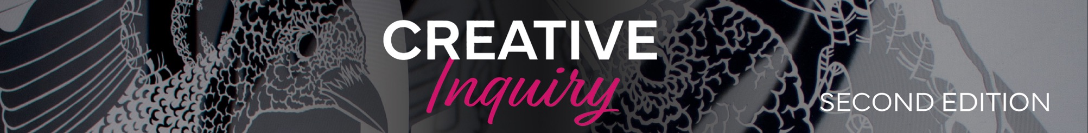
Spotlight on visual art as a career
Featuring artists reflecting on their pathways to visual art careers

Slide 2
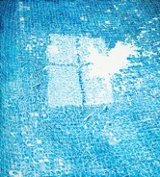
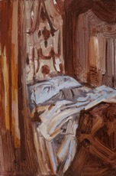
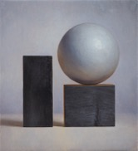
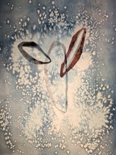
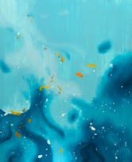
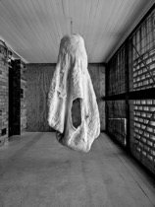
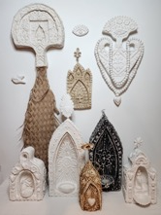
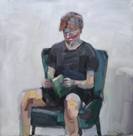
The benefits of engaging in visual art extend far beyond the classroom and provide opportunities for students to develop invaluable skills, attributes and capabilities that will allow them to contribute successfully to society after school.
Career exploration is a vital aspect of the secondary school experience. Visual Art educators play a key role not only in encouraging students to study art during their school years, but also in helping them prepare for a successful future.
By inspiring students to follow their passions, educators can foster a lifelong pursuit of visual art as a career, leading to both personal fulfillment and ongoing professional success and satisfaction. To support this, schools and educators must continue to advocate for visual art education and integrate opportunities for students to explore potential careers in visual art.
Through the provision of ‘real-life’ case studies, this resource features seven artists who reflect on their lived experience in making a career for themselves in visual art, which is not only financially viable but is also a personally enriching career choice.

Slide 3

Holly Anderson – artist
Instagram@holly.e.anderson
hollyandersonart.com
I started a Bachelor of Fine Art (QCAD) directly after high school, which felt at the time like the obvious choice. I had recently worked on an art project for a Year 12 class that had completely absorbed me; it was the first taste of an intense feeling of purpose and focus that making art still gives me. I was also in the strange position of having a lot of people in my family already operating in the field which led to an illusion that painting was an occupation levelled in risk with any other job. It was quite surprising once I entered art school and discovered the many other kinds of ‘art world’ there were, the many ways of making art and how artists made the relative instability of painting for a living, work financially and logistically. I majored in Painting which is still the principal focus of my practice. I was astonished how pleasing it was to examine one medium so specifically, how much was there to support you historically, and how much there was yet to discover. Once I graduated, I juggled many jobs so I could work flexibly on making paintings for exhibitions at artist-run spaces around my city. I met people doing similar things and began to feel very free, having found a place in the world that had not existed for me before. The more I made my work, the more myself I felt. After a few years I started some teaching work at my previous university. It was incredible to watch students go through similar struggles and breakthroughs I had been so grateful for a few years before. I am still teaching and working as a painter supported by a commercial gallery. It is a great life.
Holly Anderson
Pool (the broken window), 2022, oil on panel, 120 x 110 cm. Image courtesy the artist.

Slide 4
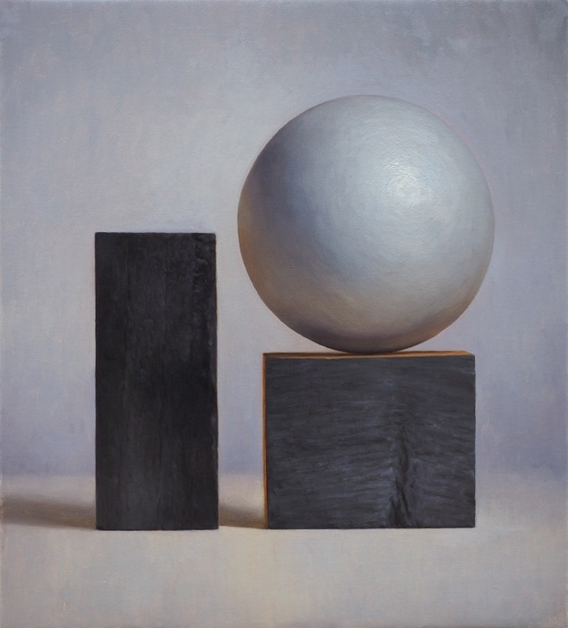
David Fenoglio – artist, educator
Instagram@fenoglio.d_art
www.davidfenoglioart.com
I studied art in high school and spent many lunchtimes in the art rooms. After finishing high school, I worked as a chef for some years and went on to study a Bachelor of Fine Art at university. During this study I continued working as a chef where creativity was also a driving force. After graduating I continued working as a chef, saving money and travelling. After some years of this and being exposed to the great art of the world, I decided to commit myself to painting. This required employment other than hospitality, so, I studied education. I am now happily working as a secondary art teacher and painting. Trying to explain why art is important is a strange thing. It is deeply engrained in my life and very important to me. Visual art, in particular of all the arts, is often a quiet space. In a busy and noisy world the quiet of visual art, the contemplation available to any artist in the studio is so important for the soul. Art allows an individual to engage with the world in an authentic way. The fundamental nature of people is creative; if it weren’t for our creativity we would not still be here as a species. Employers are heard speaking about the need for creative and adaptive thinkers. Even a few years doing visual art during high school will give you an edge in the professional world. Do art!
David Fenoglio
Scorched, 2023, Oil on linen, 46 x 41cm.
Image courtesy the artist and Jan Manton Gallery

Slide 5

Callum Francis – artist
Instagram@callumjfrancis
Art for me was a calling, one which became louder as I grew older. Irrespective of the little encouragement during high school art, I persisted with my vision of becoming an artist one day. I went on to study Literature and Art at University, helping to formulate my ideas and being able to express them through language. I then travelled around Australia working odd jobs until I was ready to make the work that meant the most to me. Painting is an incredibly rich language to express one’s interests and life. It’s valuable to be honest with who you are and allow that to be celebrated through your work. I’ve been very fortunate to show my work both nationally and internationally with many years to come. Dedicate yourself to the process and enjoy making work. A life in art is a long journey to be cherished.
Callum Francis
Gently Sail, 2024, Oil on polycotton, 167 x 137 cm.
Image courtesy the artist and Christine Hall Photographer

Slide 6


Alina Franks – educator, artist
Instagram@afar._.studio
I have two photographs taken 16 years apart that are almost identical. The first was taken when I was 4, sitting on the floor of my grandparents' kitchen, totally engrossed in drawing. The second was at art college in my studio space, in the same pose, drawing something surprisingly similar. After all these years, creating continues to make me feel whole. The process of problem-solving, working with my hands, and having the confidence to put an idea into action has been part of my everyday life—from working as a high school visual art teacher, to running a business creating artisan products for homewares stores, and renovating properties.
Initially, I didn’t choose Art as a subject in Year 9; it didn’t seem like a ‘real’ subject. However, everything changed when I saw what my friends were learning and met people who ran a local gallery. They made me question what a ‘real’ subject or job truly was. By Year 10, I was studying Art and had transformed a corner of the garage into my painting studio. The art room became my second home, and it still is today. In Year 12, I initially planned to study into Business and Law, influenced by a misguided notion of what was ‘important’. However, after attending a university open day, I became captivated by the art studios and changed my preferences to a Bachelor of Visual Art with Honours, followed by a course in Secondary Education.
Working with students and guiding them through their own creative processes is inspiring and I have kept my artistic practice alive through exhibitions, markets, and commissioned pieces. Yet, over the last couple of years, I felt a growing desire to turn my passion for creating into a business. I reached out to a homewares store in Byron Bay, sending them a collection of my images, and before I knew it, I was filling orders of 50 or more pieces at a time and expanding to other stores. What caught me off guard were the deep connections I forged with my customers. They approached me to create pieces for weddings, to honour loved ones who had passed away, and to commemorate significant milestones in their lives. What could be more important? As a creative individual, you can never predict where each artwork or opportunity will lead you. Life is not a clear map. The skills and confidence that you learn by being creative stay with you for a lifetime. Be brave and stick to your passion.
Alina Franks
Poetry for the city, 2024, mixed media installation, 115cm x 90cm x 30cm. Image courtesy the artist

Slide 7


Katie Harris-MacLeod – artist
Instagram@katieharrismacleod
www.katieharrismacleod.com
I have loved all things art for as long as I can remember; for me art has always been a meditative and therapeutic practice, that I have been fortunate enough to turn to, to tap out of the chaos of the world and tap back into my own inner world.
Growing up predominantly in Scotland, where undergraduate university education is free, it was a no brainer to go to art school and initiate the beginnings of discovering the depth of meaning of what art is and the potential art holds for all of us. I would say that my time studying Contemporary Art Practice at Duncan of Jordanstone College of Art and Design in Dundee, Scotland, were some of the most enriching and exciting years of my life so far. It truly opened my mind and gave me the opportunity to explore my creative practice.
Art is my life, I have been living this life in a professional sense for seven years now, amongst living and working across Scotland, Europe and Australia doing all manner of jobs along the way to support my practice. It’s certainly not an easy path, as a working- class person but it is integral to my being and a part of what makes this journey through life so enriching.
It takes a lot of hard work and commitment to yourself and your practice, to show up as much as you can, to grow thick skin and to decipher the hieroglyphics of grant/application writing, but in time things begin to unfold and make sense; you find your community and your audience. You most likely will have to take on many different forms of work along the way; this can be challenging but if you can flip your perspective and see these experiences as points of intrigue to inform your work, you can transform those challenges into fuel for your artistic journey. Each job, each new environment, and each person you meet contributes to the ever-evolving story that shapes your creative practice. In my case, working across Scotland, Europe, and Australia has broadened my horizons, allowing me to draw from diverse cultures, landscapes, and personal experiences. These influences all find their way into my art, enriching both my technical ability and the depth of meaning behind my work.
I think one of the most valuable lessons I've learned is that art is not just about the finished product, it’s about the process, the struggle, and the constant evolution. It’s about taking risks, challenging yourself, and finding new ways to express what’s inside of you. Even on the days when the path feels uncertain, or when the obstacles seem insurmountable, it’s that unwavering commitment to your practice, and to yourself, that ultimately makes it worthwhile. Art is a form of resilience and resistance. It is a constant reflection, a way to make sense of the world, and in doing so, I feel I am better able to make sense of myself.
Looking back on my years at Duncan of Jordanstone College of Art and Design, I realise how much it shaped the way I approach both my art and life. It gave me the tools to push beyond limitations, the confidence to trust in my own voice, and the courage to take chances in ways I never thought possible. Now, as I continue to navigate the professional art world, I know that this journey is a lifelong one—one filled with highs and lows, uncertainty and clarity, frustration and satisfaction. But at the end of the day, I wouldn’t trade it for anything. Art is my language, my connection to the world, and it will always be at the core of everything I do.
Katie Harris-MacLeod
Falling through space (the three of us), 2024, Cyanotype, Salt, Bloodwood Tree Sap and Graphite on 300gsm Watercolour Paper, 76 x 56 cm. Image courtesy the artist.
Machlag (Womb) – Death, 2017, One of three large womb-like soft sculptures made of sheep’s wool, lichen, horses' hair, bird nests, hand felted and woven, Dimensions variable. Image courtesy the artist.

Slide 8

Miranda Hine – artist, curator, writer
Instagram@moomhine
www.mirandahine.com.au
My mum is an artist and art teacher so I was brought up to value art and its role in helping you see the world in interesting ways. At school, outside of a few teachers, it wasn’t seen as a realistic career pathway, so I discounted it as an option for university study before I realised there was nothing else I really wanted to do.
At university, I studied Fine Art majoring in Interdisciplinary Sculpture at the Queensland College of Art. I had some incredible tutors who were world-class artists and thinkers. It was a great experience, but I personally didn’t see myself having an art career afterwards. I had become much more interested in writing about other artists’ practices, and probably didn’t feel like I had enough to say to be an artist myself. I didn’t practise for about five years while I studied a Masters in Museum Studies and worked, interned and volunteered, eventually becoming a curator.
I felt a pull back to my own practice in 2021 and I started painting. I do both careers simultaneously right now, making art and putting exhibitions together in a museum. I like the balance that that gives me, and they feed into each other well. There’s no one pathway into an art career, and no single model for making it work. You need to do what feels right for you.
Miranda Hine
Dennis Severs’ House (bed), 2023, Oil on board, 22.8 x 15cm. Image courtesy the artist and MARS Gallery

Slide 9

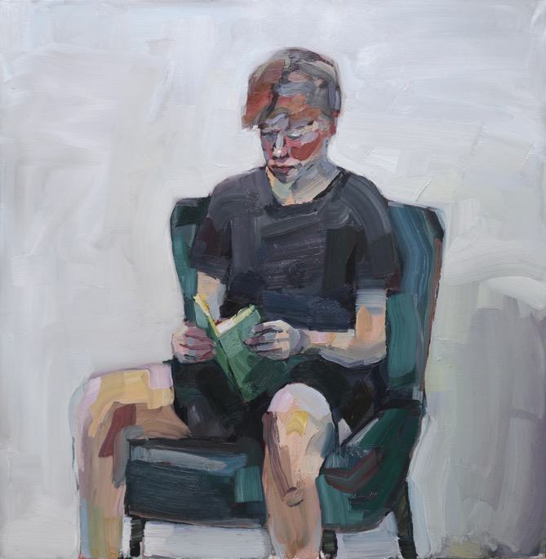
Dylan Jones – artist, educator Instagram@dylanjonesart dylanjonesart.com
Growing up in a family of architects, creativity surrounded me from an early age. My great-grandfather, although a private man, was a prolific artist and I was always encouraged to explore the world through an artistic lens, so it was inevitable that I would be an artist. Despite moments of self-doubt during school, pressure to conform or a degree of uncertainty about the path ahead, art was always the one thing that was constant and that felt true to me. Eventually I enrolled in art school and focused on art and music, though I also considered teaching as a possible career. After graduating, I juggled art with a landscaping business to make ends meet. It wasn’t glamorous but it provided the stability I needed. After a period of self-reflection however, I made the decision to pursue my art full-time. It wasn’t without financial uncertainty but the freedom to create was fulfilling. Travel has played a huge role in my work, offering new perspectives and inspiration that I may not have found otherwise. I would advise anyone looking to pursue a creative career to try to refine a variety of skills; the more tools you have in your kit, the more opportunities you will be presented with. Constructive criticism from those you respect is also crucial. You need to be open to it to grow, even if it may be uncomfortable at times. There is a balance to be achieved between following your artistic passion and ensuring that your livelihood is sustainable. Art is not just about inspiration, but also about practicality. I’m grateful for my time at art school but if I were to offer advice to aspiring artists today, I’d say that a hands-on approach is just as important.
Dylan Jones
Young Man (Brisbane Portrait Prize), 2024, Oil on aluminium, 122x120 cm. Image courtesy the artist

